Slide 1
Association of Energy Engineers Heritage Sandy Springs February 29th , 2016 Converting to CNG as an Alternate Transportation Fuel
Billy Malone SWANA TDIBR Landfills
DeKalb County Sanitation Board Clean Cities-GA
Sanitation Director

Slide 2
Seminole Road Landfill
Phase 3 – Active
Phase 4 - Under Construction
Aerial View Looking South

Slide 3
DeKalb County Sanitation
1937 - Sanitation began Collection & Disposal of MSW
1977 - Seminole Landfill began disposal operations
2000 – Started Flaring Landfill Gas (54% Methane)
Landfill Gas Flow approximately 2,200 scfm
2006 – Landfill Gas to Electricity (LFGTE) 3.2 MW of Electricity (First - Georgia Power G-Energy Program - 9 States)
LFGTE Facility Cost $ 5,000,000 – Design Build (in-house)
Annual Sale of Electricity to Georgia Power $ 1,200,000
(includes green tag attributes – REC’s)
ROI 4.2 years – Return of Capital Investment
Maintenance and Utilities $ 575,000
Annual Net Profit Operating the Facility $ 625,000
Electricity Generation uses 1,100 scfm of LFG

Slide 4
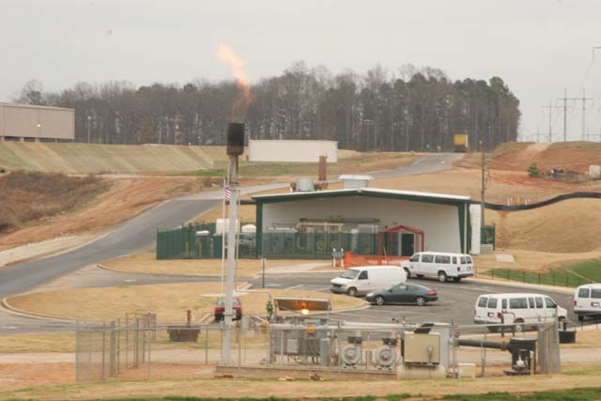

Slide 5
Seminole Road Landfill
April 2012 – Renewable Fuels Facility began converting Landfill Gas into Renewable Natural Gas
Inject into the 16 inch high pressure AGL Pipeline
1,000 scfm of Landfill Gas produces 300 mmbtu / day
October 2012 – Sanitation began dispensing CNG as Transportation Fuel – Public Access $ 2.10 per GGE
Solid Waste, Utilities, BOE, State, Transporters – primary users – MARTA is a backup user

Slide 6
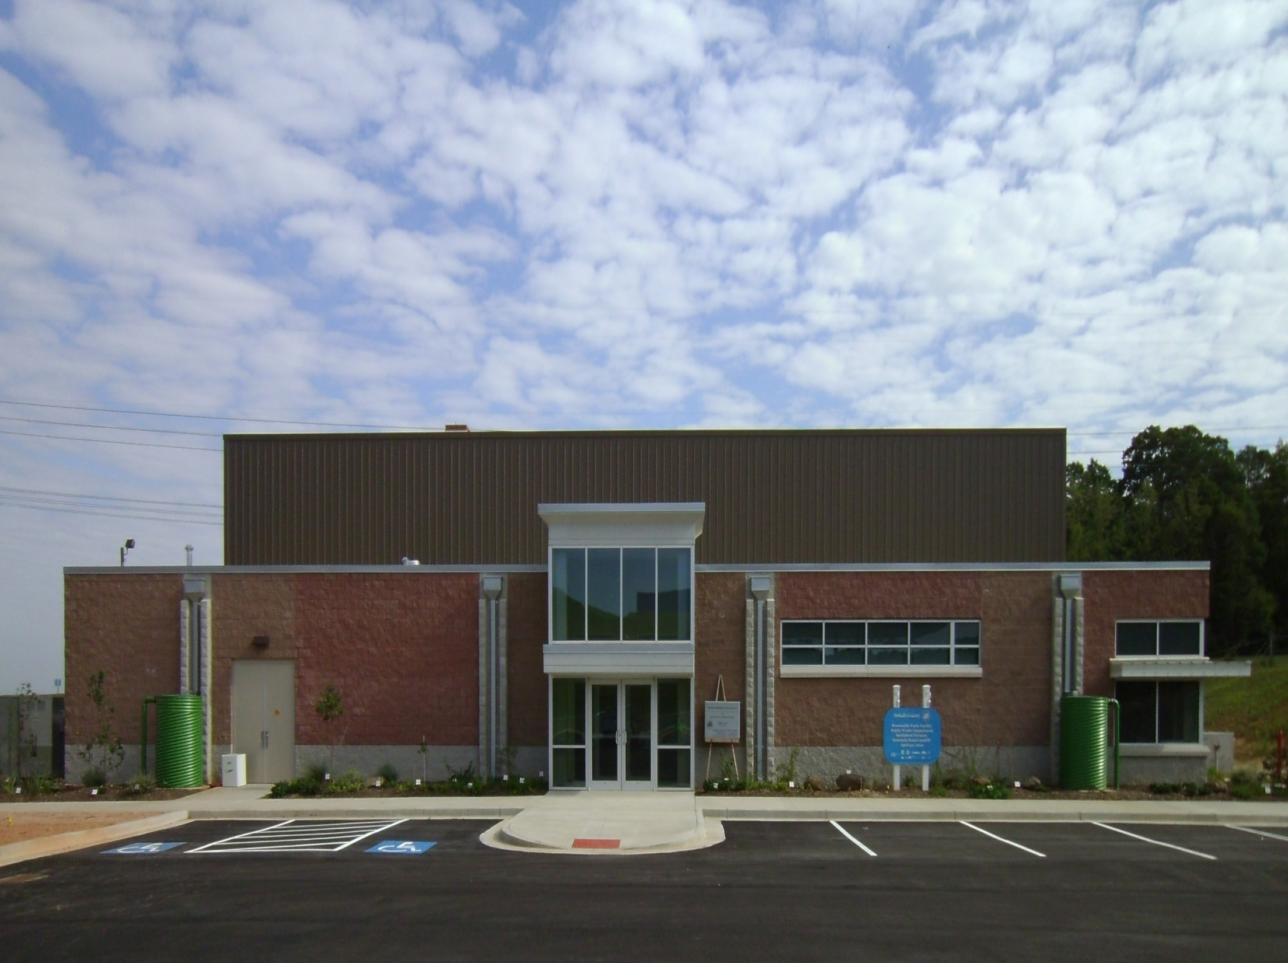
20 Foreign Countries have Visited
LEED GOLD Certification

Slide 7
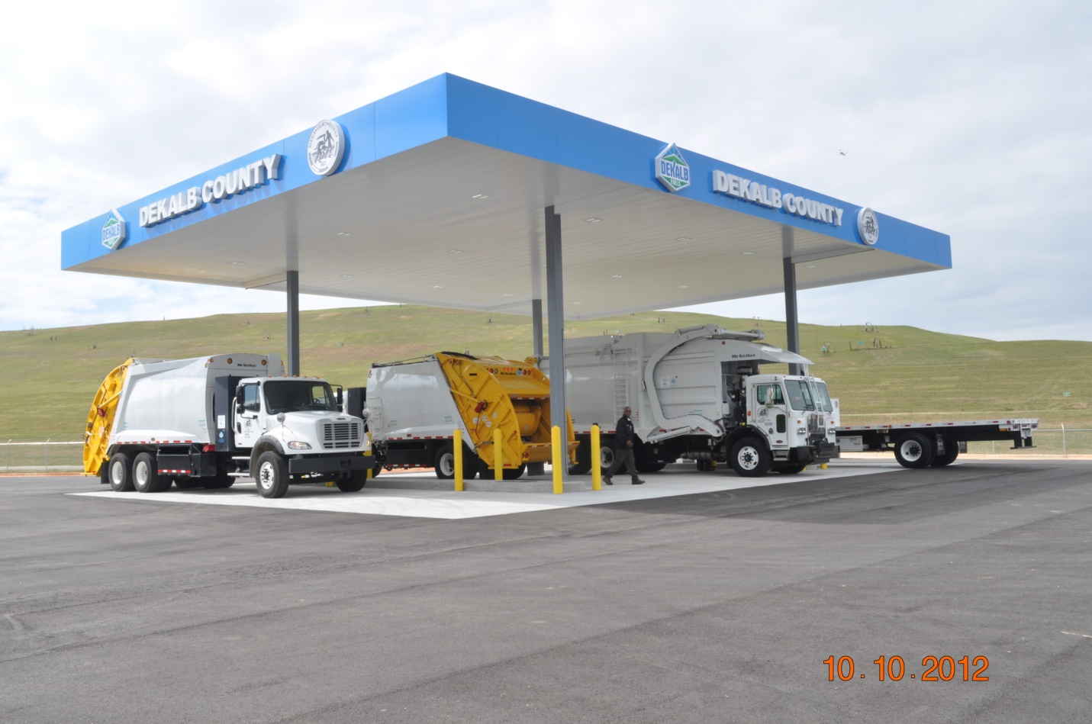
DeKalb Sanitation has 86 CNG Vehicles

Slide 8
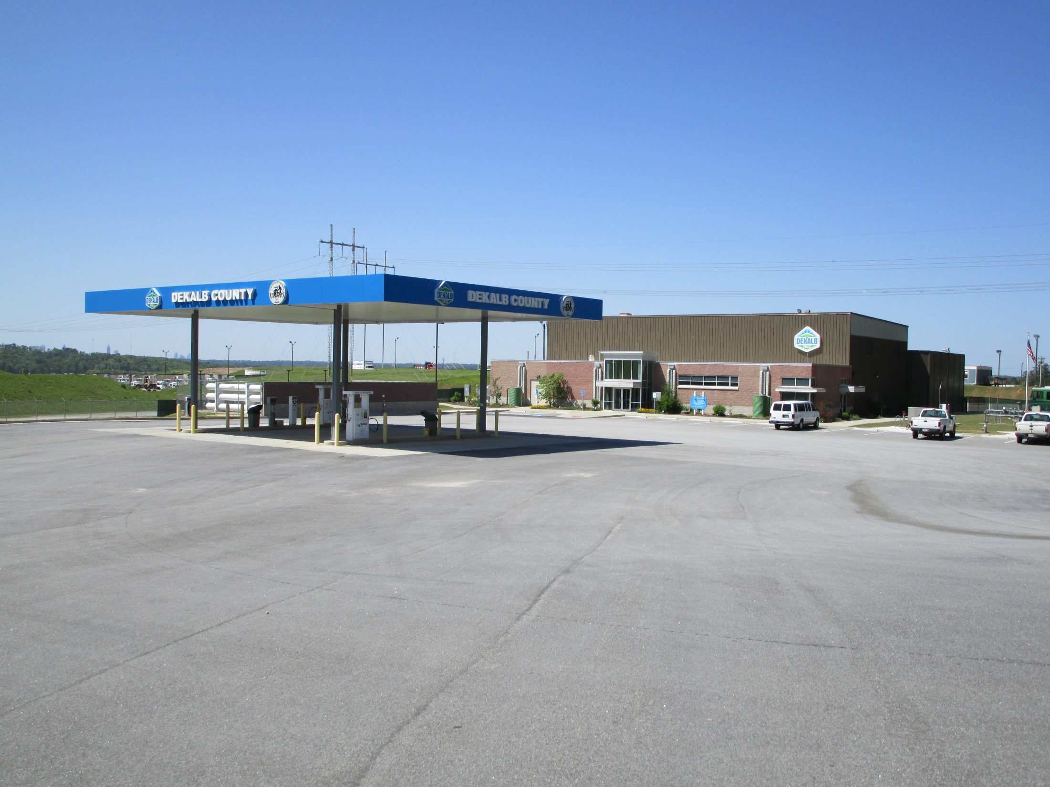

Slide 9
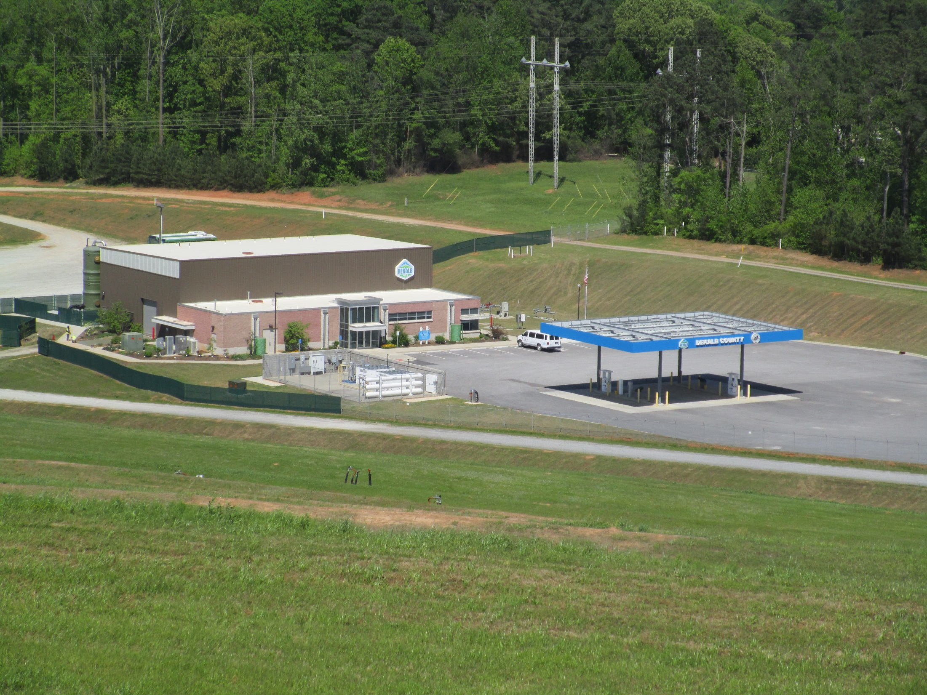

Slide 10
CNG Fueling Station & Renewable Fuel Facility ROI
CNG Fuel Station Cost $ 2,000,000 (Fast Fill)
Sale of CNG to the General Public = $ 315,000
Sanitation Fuel Savings = $ 540,000 (40% of CNG Fleet)
Contract Maintenance of Facility $ 114,000
ROI = 2.70 Years
Renewable Fuels Facility Capital Cost $ 12,000,000
Annual Sale (Brown) Natural Gas via Pipeline = $ 1,031,505
1000 scfm LF Gas @ 54% Methane = 800 mmbtu / day x 365 x $4.00 est. Henry Hub Price x 0.90% operation efficiency = $ 1,051,200
Annual Sale of RIN’s (D3 rating) = $ 3,081,855
800 x 365 x 11.727 D3 RIN x 0.90 % efficiency = $ 3,081,855
10% CNG/LNG Facility + 15% 3rd Party Fees + EM = $ 800,000
Maintenance of Facility including Utilities $ 784,000
ROI = 4.74 Years

Slide 11
CNG Station Opens in Decatur
$ 1,200,000 grant from AGL
$ 500,000 match Sanitation
2 dispensers, 4 hoses – 1 maximum fill
Public Access
1.5 miles from I-285
Open 5 days week – Monday thru Friday
6:00 am to 10:30 pm
Operational March 2016
Sixth Public CNG Station in DeKalb County

Slide 12
Units and MPG for CNG
Sanitation began operating CNG vehicles in April 2012
39) in 2012, (38 Solid Waste, 1 Watershed Sedan)
2) in 2013, (Solid Waste)
35) in 2014, (40 Solid Waste, 5 Senior Citizen Buses)
16) in 2015, (16 Solid Waste)
24) in 2016, (24 Solid Waste)
30) in 2017, (30 Solid Waste)
146) Anticipated CNG Conversion Units by the end of 2017
This equals 80% of the vehicles in Sanitation as dedicated CNG Vehicles

Slide 13
Units and MPG for CNG
Sanitation 180 operating vehicles
~MPG ~Life
Tractor Trailer (Transfer Station) Vehicles 3.1 8 yrs.
Front End Loader (Commercial) Vehicles 2.4 8 yrs.
Rear End Collection (Residential) Vehicles 2.5 9 yrs.
Roll-off Container (Commercial) Vehicles 5.3 12 yrs.
Other Solid Waste (Heavy Duty)Vehicles 8.1 12 yrs.
Supervisor Pick ups (F-250) 16.8 12 yrs.
Employee Van Shuttles (E-350) 17.6 12 yrs.
Sedans – (Honda Civics) 30.2 12 yrs.

Slide 14
Gas 2.23 2.30 3.91 1.86 2.64 3.69 3.65 3.34 3.10 2.10 1.70
Diesel 2.32 2.37 4.22 2.19 2.50 3.62 4.00 3.90 3.75 3.00 2.00
MSW LF (Public) 1.25 1.38 1.45 1.75 1.90 2.10 2.10 2.09 2.10
Seminole CNG (Public) 2.10 2.10 2.10 2.10 2.10
CNG (Public) 1.94 2.34 1.63 1.86 2.06 2.34 2.39 2.30 2.25 2.15
CNG (Private) 0.80 1.00 0.90 0.85 0.75 0.75 0.75
Average price for fuel and maintenance

Slide 15
Conversion to CNG ROI
Conversion Cost for most Heavy Duty Vehicles
90% of the total cost to Covert is Storage
$ 8,000 ~ (15 Gallons)
$ 15,000 ~ (30 Gallons)
$ 27,000 ~ (45 Gallons)
$ 39,000 ~ (60 Gallons)
$ 52,500 ~ (75 Gallons)

Slide 16
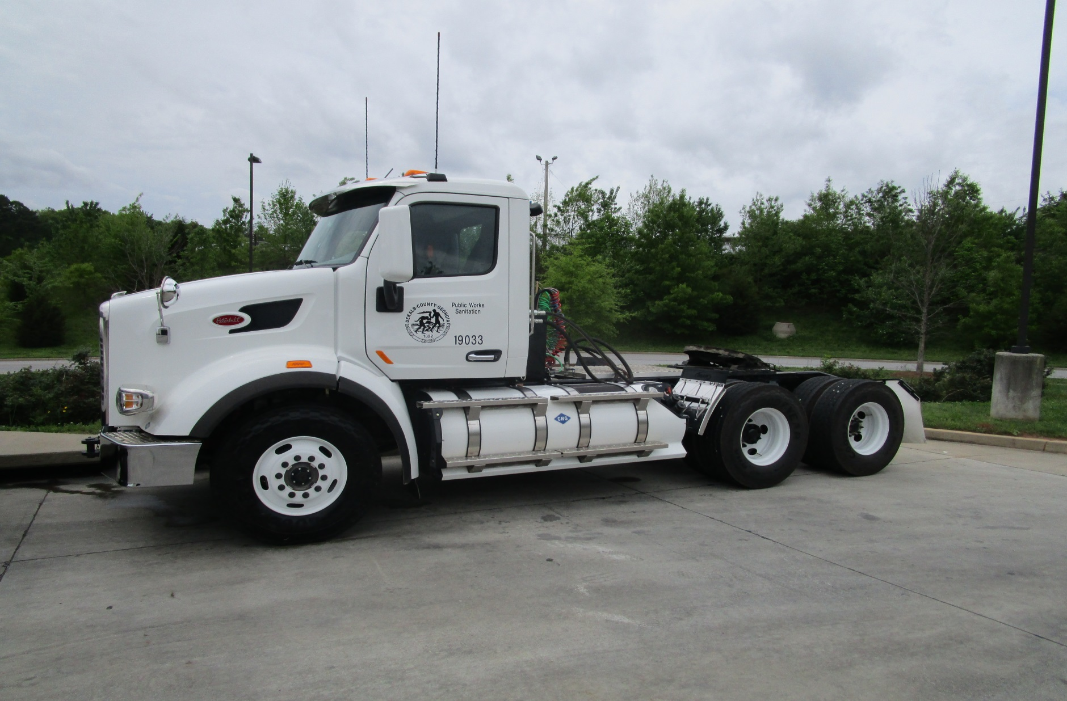
CNG Tractor Trailer Vehicle

Slide 17
Conversion to CNG ROI
1A – Tractor Trailer – 3rd Party Owned CNG Fueling Station
175 Miles per Transfer Day = 54,600 Miles per Year (6 days/week)
Fuel Cost $ 1.65 (taxes exempt); Diesel Average $ 2.00, Difference $ 0.35
54,600 miles ÷ 3.1 MPG = 17,613 x $ 0.35 = $ 6,165 Savings / Year
75 Gallon CNG Tank @ $ 52,500 ÷ $ 6,165 = 8.52 Years ROI ☑
1B – Tractor Trailer – County Owned CNG Fueling Station
175 Miles per Transfer Day = 54,600 Miles per Year (6 days/week)
Fuel Cost $ 0.75 (taxes exempt); IRS Rebate $ 0.50, Diesel $ 2.00, Difference $1.75
54,600 miles ÷ 3.1 MPG = 17,613 x $ 1.75 = $ 30,822 Savings / Year
75 Gallon CNG Tank @ $52,500 ÷ $ 30,822 = 1.70 Years ROI ☑
Average Depreciation Life ~ 9 Years
Storage Tanks Life ≤ 20 Years

Slide 18
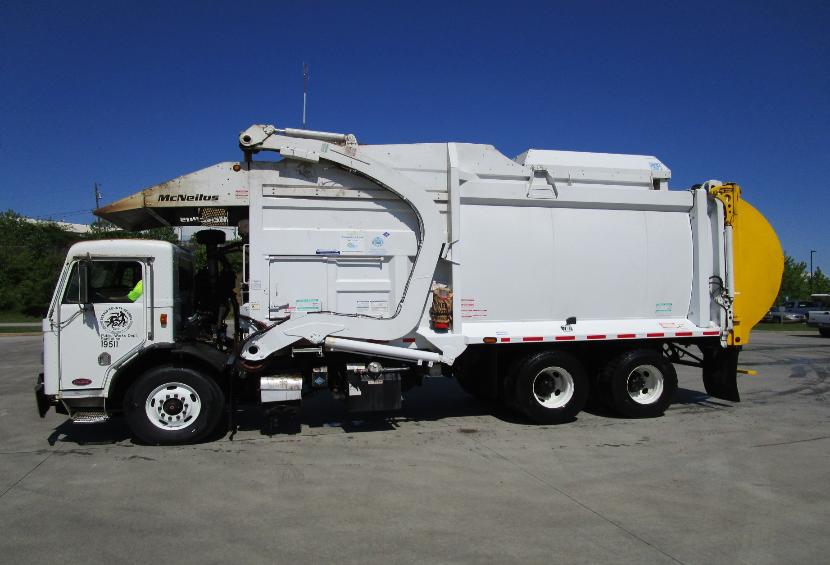
CNG Front End Loader Vehicle

Slide 19
Conversion to CNG ROI
2A – Front End Loader – 3rd Party Owned CNG Fueling Station
100 Miles per Collection Day = 31,200 Miles per Year (6 days/week)
Fuel Cost $ 1.65 (taxes exempt); Diesel Average $ 2.00, Difference $ 0.35
31,200 miles ÷ 2.4 MPG = 13,000 x $ 0.35 = $ 4,550 Savings / Year
60 Gallon CNG Tank @ $ 39,000 ÷ $ 4,550 = 8.57 Years ROI ☑
2B – Front End Loader – County Owned CNG Fueling Station
100 Miles per Collection Day = 31,200 Miles per Year (6 days/week)
Fuel Cost $ 0.75 (taxes exempt); IRS Rebate $ 0.50, Diesel $ 2.00, Difference $1.75
31,200 miles ÷ 2.4 MPG = 13,000 x $ 1.75 = $ 22,750 Savings / Year
60 Gallon CNG Tank @ $39,000 ÷ $ 22,750 = 1.71 Years ROI ☑
Average Depreciation Life ~ 9 Years
Storage Tanks Life ≤ 20 Years

Slide 20
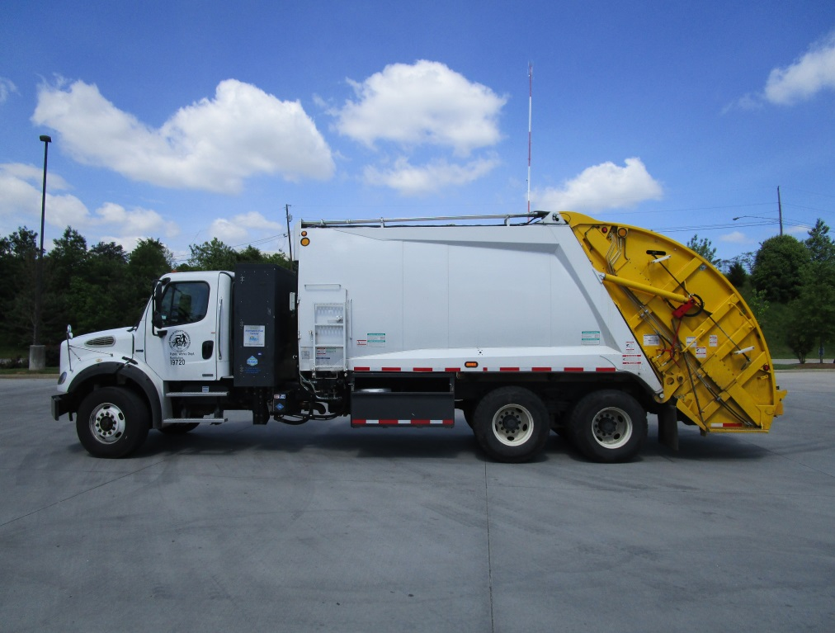
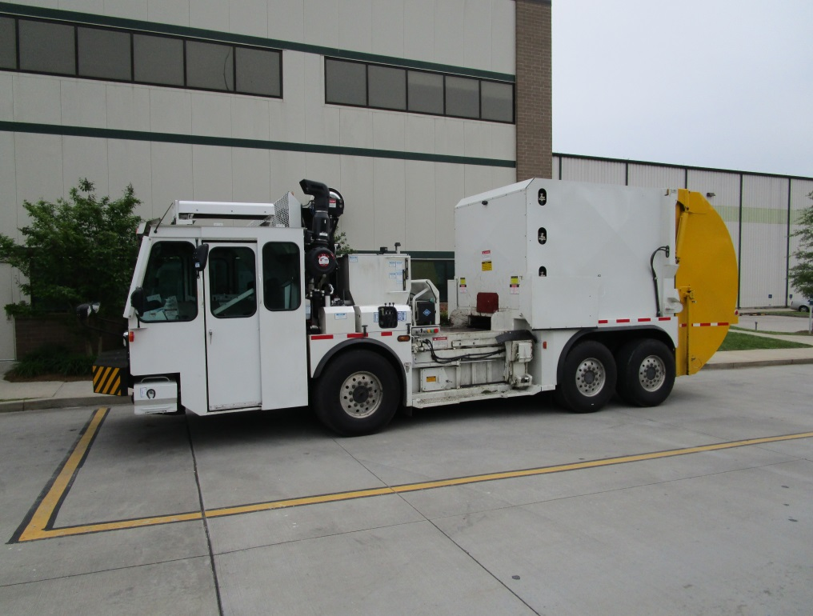
CNG Residential Vehicles
Traditional Rear Loader
1 Driver / 2 Collectors
Low Loading Side Loader
2 Driver / Collectors

Slide 21
Conversion to CNG ROI
3A – Residential Rear Loader – 3rd Party Owned CNG Fueling Station
100 Miles per Collection Day = 25,000 Miles per Year (5 days/week)
Fuel Cost $ 1.65 (taxes exempt); Diesel Average $ 2.00, Difference $ 0.35
25,000 miles ÷ 2.5 MPG = 10,000 x $ 0.35 = $ 3,500 Savings / Year
45 Gallon CNG Tank @ $27,000 ÷ $ 3,500 = 7.71 Years ROI ☑
3B – Residential Rear Loader – County Owned CNG Fueling Station
100 Miles per Collection Day = 25,000 Miles per Year (5 days/week)
Fuel $ 0.75 (taxes exempt); IRS Rebate $ 0.50, Diesel $ 2.00, Difference $1.25
25,000 miles ÷ 2.5 MPG = 10,000 x $ 1.25 = $ 12,500 Savings / Year
45 Gallon CNG Tank @ $27,000 ÷ $ 12,500 = 2.16 Years ROI ☑
Average Depreciation Life ~ 9 Years
Storage Tanks Life ≤ 20 Years

Slide 22
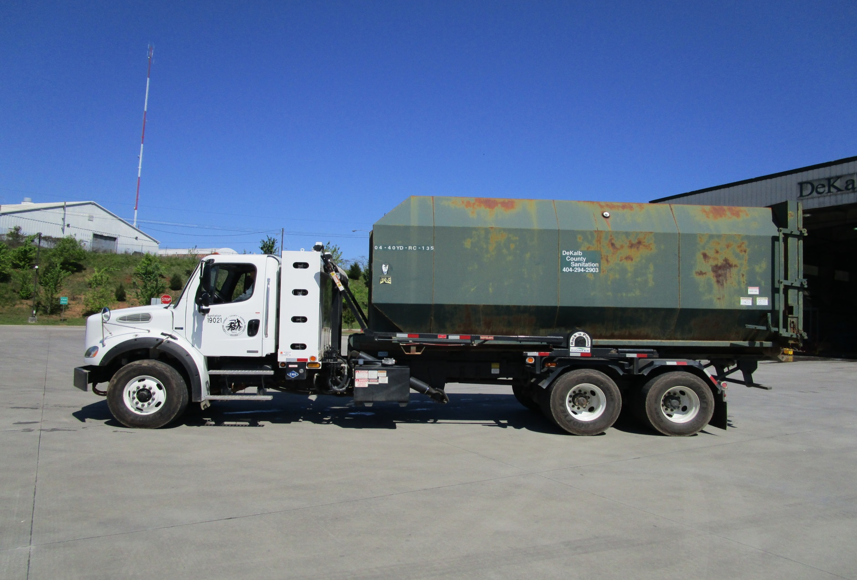
CNG Roll-off Vehicle

Slide 23
Conversion to CNG ROI
4A – Roll-off Vehicle – 3rd Party Owned CNG Fueling Station
100 Miles per Service Day = 31,200 Miles per Year (6 days/week)
Fuel Cost $ 1.65 (taxes exempt); Diesel Average $ 2.00, Difference $ 0.35
31,200 miles ÷ 5.3 MPG = 5,887 x $ 0.35 = $ 2,060 Savings / Year
45 Gallon CNG Tank @ $27,000 ÷ $ 2,060 = 13.11 Years ROI ☒
4B – Roll-off Vehicle – County Owned CNG Fueling Station
100 Miles per Service Day = 31,200 Miles per Year (6 days/week)
Fuel Cost $ 0.75 (taxes exempt); IRS Rebate $ 0.50, Diesel $ 2.00, Difference $1.75
31,200 miles ÷ 5.3 MPG = 5,887 x $ 1.75 = $ 10,302 Savings / Year
45 Gallon CNG Tank @ $27,000 ÷ $ 10,302 = 2.62 Years ROI ☑
Average Depreciation Life ~ 12 Years
Storage Tanks Life ≤ 20 Years

Slide 24
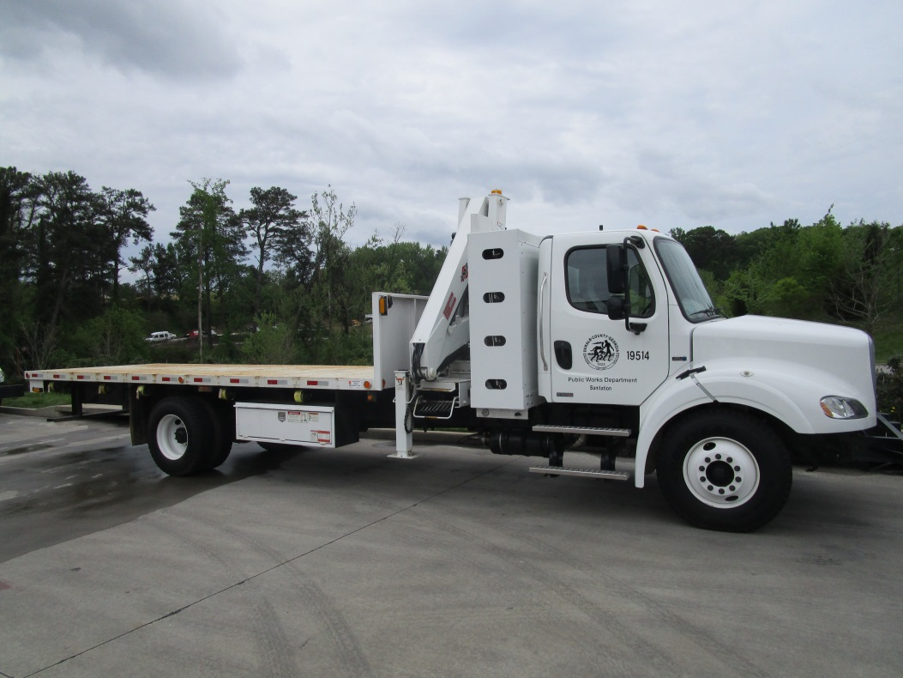
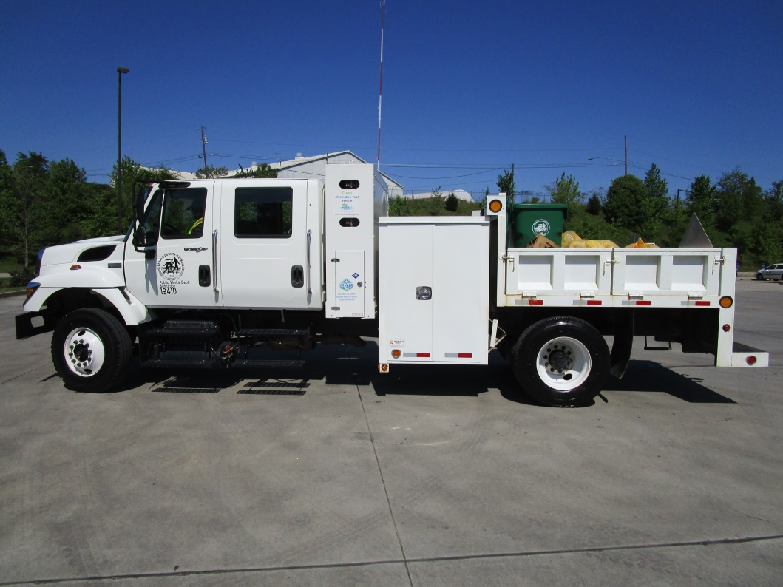
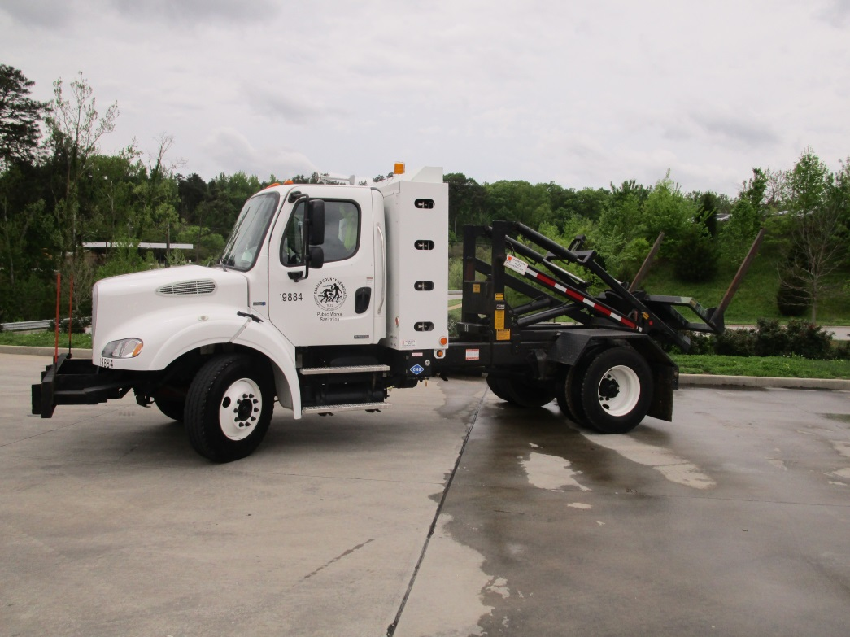
CNG Utility Vehicles
Crew Cab
Utility Vehicle
Container
Delivery Vehicles

Slide 25
Conversion to CNG ROI
5A – Utility Vehicle – 3rd Party Owned CNG Fueling Station
60 Miles per Service Day = 15,600 Miles per Year (5 days/week)
Fuel Cost $ 2.00 (taxes exempt); Diesel Average $ 3.00, Difference $ 1.00
15,600 miles ÷ 8.1 MPG = 1,926 x $ 1.00 = $ 1,926 Savings / Year
45 Gallon CNG Tank @ $27,000 ÷ $ 1,926 = 14.0 Years ROI ☒
5B – Roll-off Vehicle – County Owned CNG Fueling Station
60 Miles per Service Day = 15,600 Miles per Year (5 days/week)
Fuel Cost $ 0.75 (taxes exempt); IRS Rebate $ 0.50, Diesel $ 3.00, Difference $2.75
15,600 miles ÷ 8.1 MPG = 1,926 x $ 2.75 = $ 5,297 Savings / Year
45 Gallon CNG Tank @ $27,000 ÷ $ 5,297 = 5.01 Years ROI ☑
Average Depreciation Life ~ 12 Years
Storage Tanks Life ≤ 20 Years

Slide 26
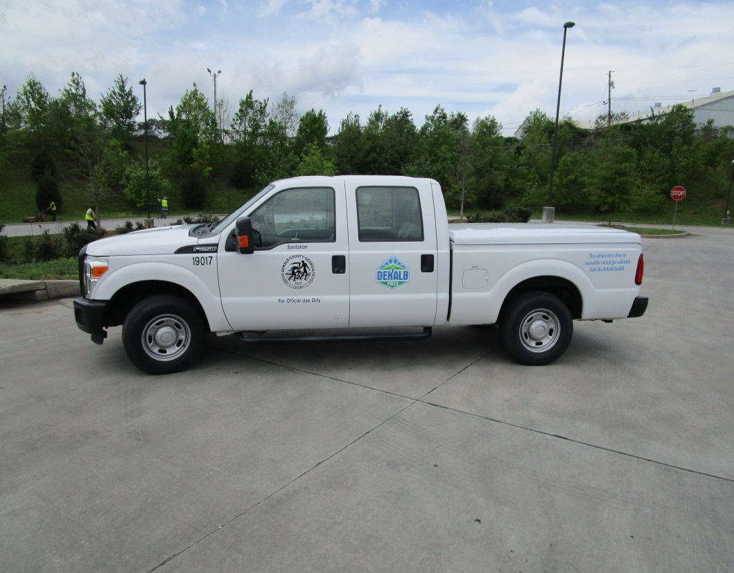
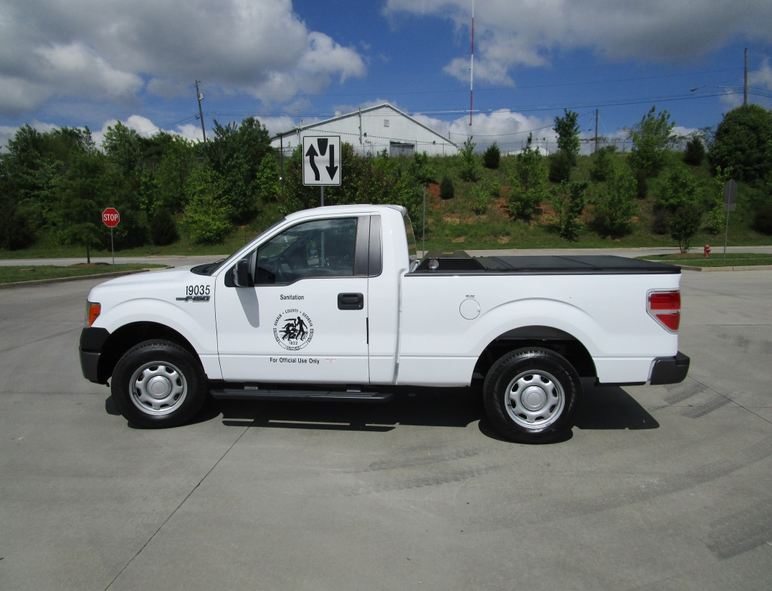
CNG Pickup Truck Vehicles
Four Door Crew Cab
Pickup Truck
Two Door
Pickup Truck

Slide 27
Conversion to CNG ROI
6A – Pickup Truck – 3rd Party Owned CNG Fueling Station
70 Miles per Service Day = 19,500 Miles per Year (5 days/week)
Fuel Cost $ 1.65 (taxes exempt); Gasoline $1.70, Difference $ 0.05
19,500 miles ÷ 16.8 MPG = 1,161 x $ 0.05 = $ 58 Savings / Year
15 Gallon CNG Tank @ $8,000 ÷ $ 58 = 138 Years ROI ☒
6B – Pickup Truck – County Owned CNG Fueling Station
70 Miles per Service Day = 19,500 Miles per Year (5 days/week)
Fuel Cost $ 0.75 (taxes exempt); IRS Rebate $ 0.50, Gas $ 1.70, Difference $1.45
19,500 miles ÷ 16.8 MPG = 1,161 x $ 1.45 = $ 1,683 Savings / Year
15 Gallon CNG Tank @ $8,000 ÷ $ 1,683 = 4.75 Years ROI ☑
Average Depreciation Life ~ 12 Years
Storage Tanks Life ≤ 20 Years

Slide 28
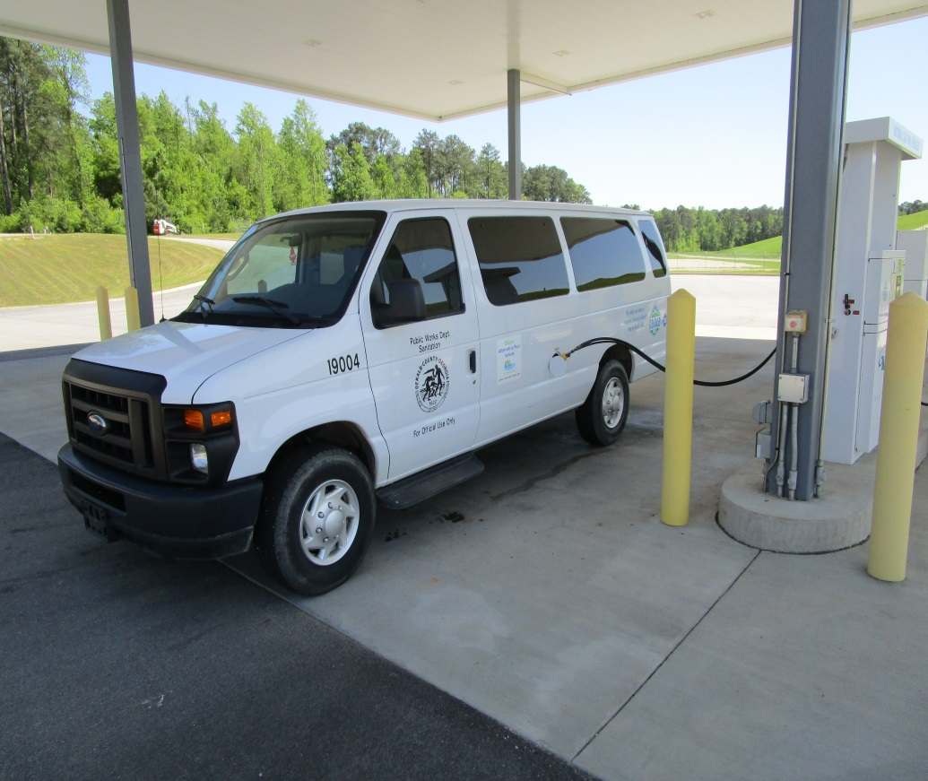
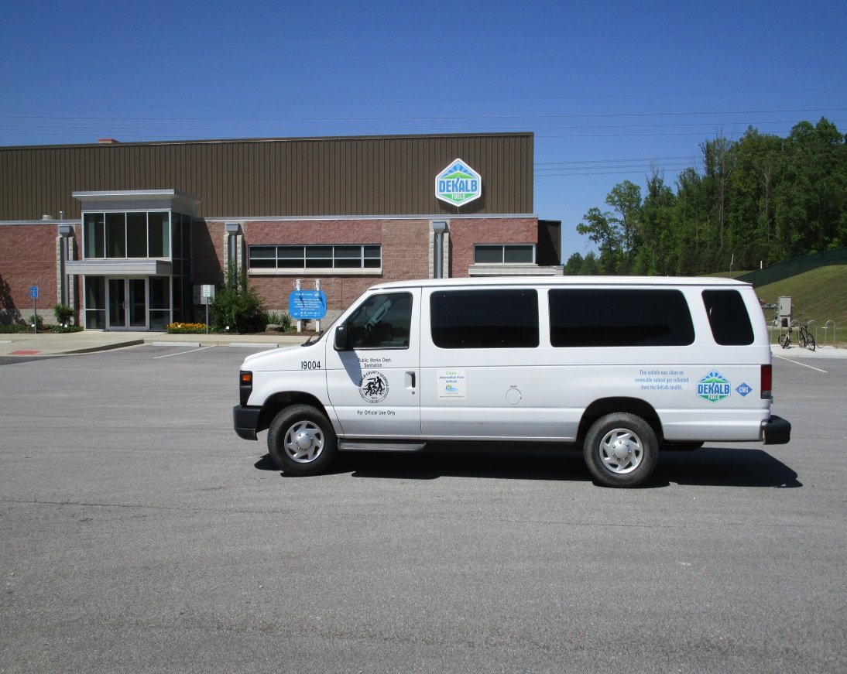
CNG Passenger Vans

Slide 29
Conversion to CNG ROI
7A – Passenger Van – 3rd Party Owned CNG Fueling Station
100 Miles per Service Day = 26,000 Miles per Year (5 days/week)
Fuel Cost $ 1.65 (taxes exempt); Gasoline $ 1.70, Difference $ 0.05
26,000 miles ÷ 17.6 MPG = 1,477 x $ 0.05 = $ 73.85 Savings / Year
15 Gallon CNG Tank @ $8,000 ÷ $ 73.85 = 108 Years ROI ☒
7B – Pickup Truck – County Owned CNG Fueling Station
100 Miles per Service Day = 26,000 Miles per Year (5 days/week)
Fuel Cost $ 0.75 (taxes exempt); IRS Rebate $ 0.50, Gas $ 1.70, Difference $1.45
26,000 miles ÷ 17.6 MPG = 1,477 x $ 1.45 = $ 2,142 Savings / Year
15 Gallon CNG Tank @ $8,000 ÷ $ 2,142 = 3.73 Years ROI ☑
Average Depreciation Life ~ 12 Years
Storage Tanks Life ≤ 20 Years

Slide 30
LFG to RNG Economics
2008 - High Btu - High Volumes ( ≥ 3,000 scfm ) – US EPA LMOP
2009 - High Btu - Medium Volumes (1,500 - 2,000 scfm)
2010 – High Btu – Lower Volumes ( 1,000 – 1,500 scfm)
2012 – Transportation CNG Fuel on-site ( > 500 scfm )
Nitrogen and Oxygen still in the Fuel – Void Warranty by Engine Companies
2014 – High Btu – Small Volumes ( 500 – 1,000 scfm)
~ 28 MSW Landfills are High Btu Plants with the potential to Generate D3 RIN’s

Slide 31
LFG to RNG Economics
Based of 5 year or less ROI some considerations
less than 2 miles to a major natural gas pipeline (6” or greater)
≥ 45 % methane (active MSW landfills)
Closed MSW Landfills have potential for ~ 20 years
Once a Landfill stops accepting MSW Methane reduces by 3% per year
≤ 10 % nitrogen (difficult to remove)
MSW Landfills should not produce more than 5% nitrogen
≤ 2 % oxygen (safety issues)
MSW Landfills should not produce more than 1.5% oxygen

Slide 32
Low-Carbon Fuel Standard Emissions Comparison for Various Fuel Sources
Includes
All Forms
Of Fuels
Traditional Naturally
Occurring Fossil Natural Gas
E85
RNG Facilities at MSW Landfills
29 % Reduction
in GHG Emissions
88 % Reduction
in GHG Emissions

Slide 33
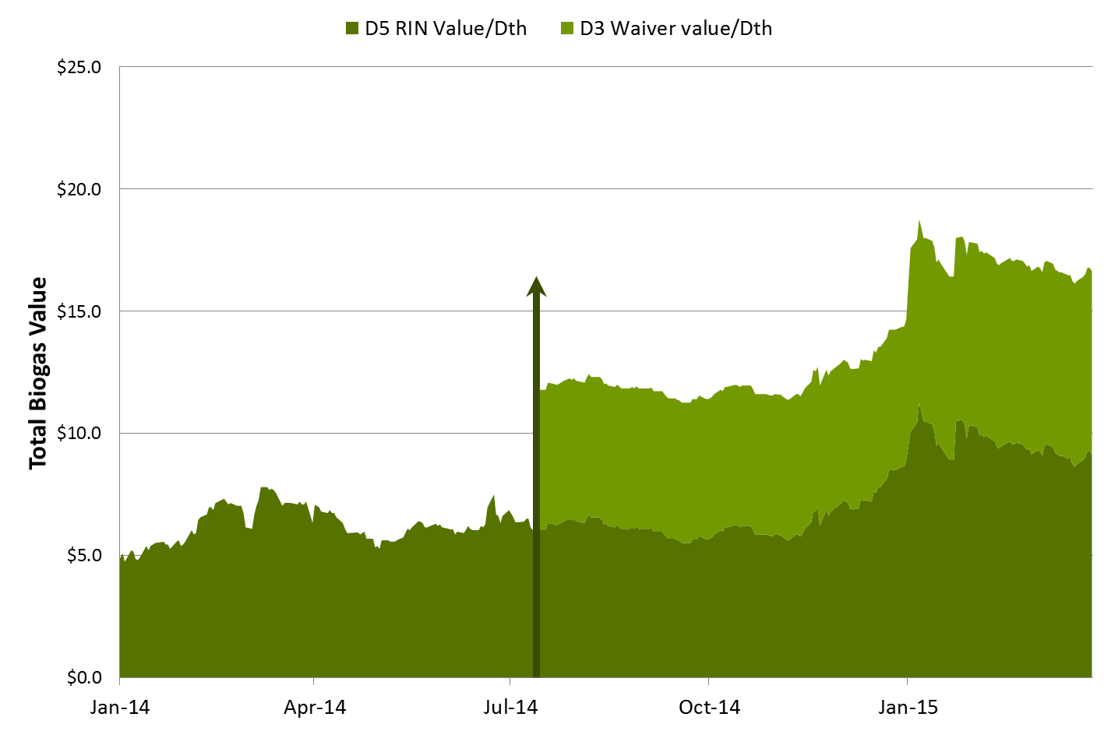
$16.00
Pathways II Final Rule published by EPA on 7/18/2014
Dth = 1) mmbtu. Seminole produces 300 mmbtu / day.
$ 16.00 X 300 = $ 4,800 / day > marketing and other associated fees

Slide 34
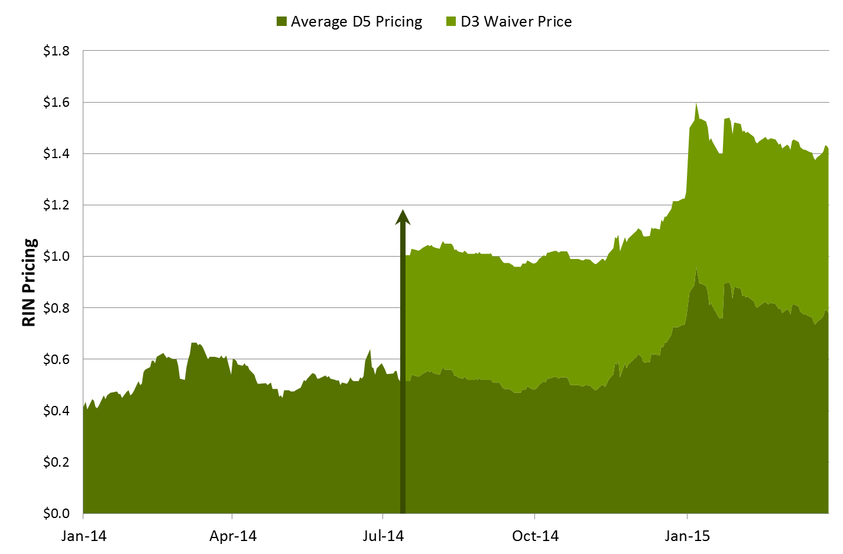
* Elements Markets
$1.4
Dth or mmbtu = 11.73 RIN s. Seminole produces 300 mmbtu / day. 300 mmbtu x 11.73 RINs x $1.4 = $ 4,926 / day > marketing and other associated fees

Slide 35
Contact Information
Billy Malone
DeKalb County Sanitation Director
404-294-2900
wcmalone@dekalbcountyga.gov
SWANA – TDIBR Landfills
Board of Directors Clean Cities -Georgia

