Slide 1
Utility Conservation Strategies for Owners Russell Holly
March 2022
Notes:
1

Slide 2
My Background
19 years helping customers reduce water and energy use with ESCOs
13 years with FCBOE

Slide 3
Fulton Facts
16MM square feet over ~100 facilities
$13MM annual utility spend
30.3 kBTU/sf
Energy Star Certified Facility Leader
E-SPLOST is key

Slide 4
Supply Side
Competitively bid electric provider for new facilities
Georgia Power's Real-time Pricing
Use school rate schedules
24/365 - Peak demand window for some utilities

Slide 5
Overall Strategy
Design it efficiently
Install it and commission it
Operate it efficiently

Slide 6
Design

Slide 7
Design it
WSHPs
RTUs for year-round occupant areas
Condensing Boilers
Lighting controls including full blackout
Reduced outside air from ionization units
Dedicated outside air units/ERUs
BAS controls on everything
Metering: electric/gas/tower makeup water
Design requirements & standards

Slide 8
Construction
and
Cx

Slide 9
Construction & Cx
3rd party commissioning
Internal commissioning
HVAC equipment is secondary to controls
Confirm operation
Standard sequences
Tweak unit setpoints to match facility

Slide 10
BAS Framework
Automated Logic on 100% of facilities
Full control of DOAS/ERUs
Security and fire system monitoring
Emergency generator monitoring
Tower chemical treatment control
Power phase loss
Metering!

Slide 11
Operations

Slide 12
Question
When do you want to know you're wasting energy/water?
Year end
Two weeks after the billing period ends
Now

Slide 13
Level of Analysis
BTU/sf & $/sf on annual basis
Monthly usage
Hourly usage

Slide 14
Water use Monitoring
Not for all schools
Provides high usage alerts via e-mail
Keeps historical data in dashboard
Reduces risks/surprises
FCBOE is using this for high schools and middle schools with irrigation

Slide 15
Water Waste
Why is the water bill high?

Slide 16
Water Use Monitoring

Slide 17
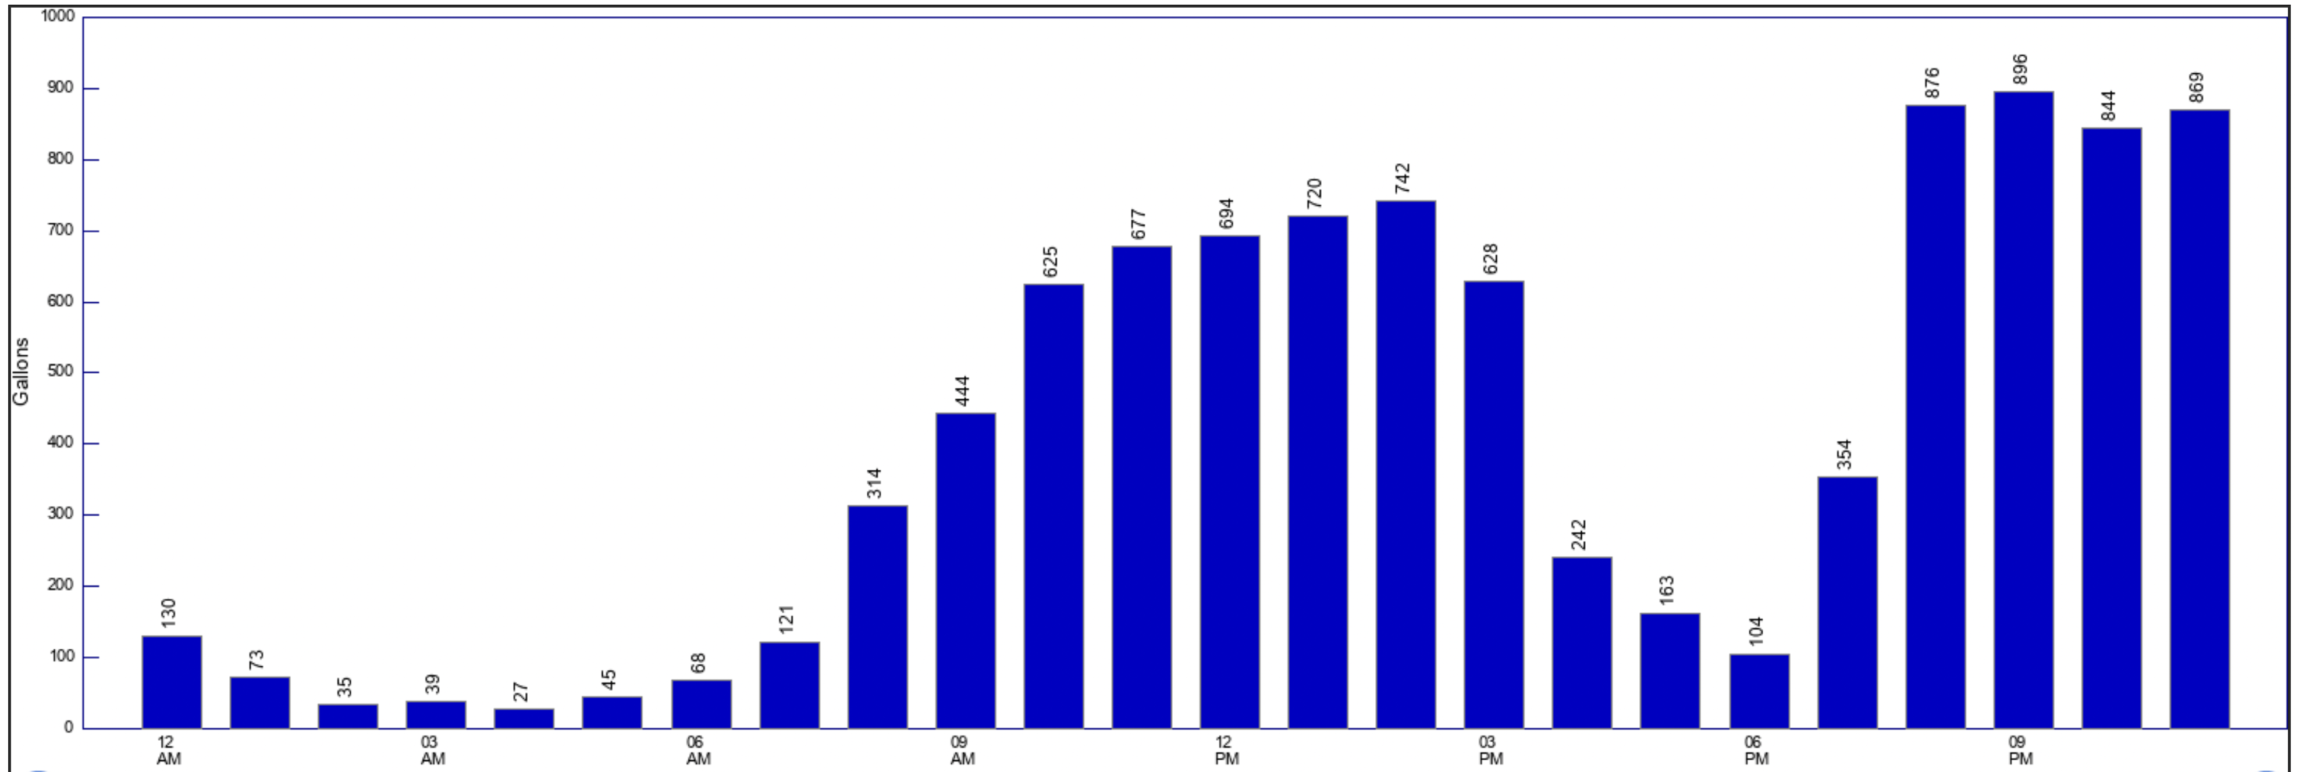
Water Use Monitoring
Daily Use Chart

Slide 18
BAS Strategies
Scheduling aggressively
Limit HVAC overrides
Optimal start at each unit
Demand limiting
RTP rate response
Monitoring Central plant start times
Dashboards

Slide 19
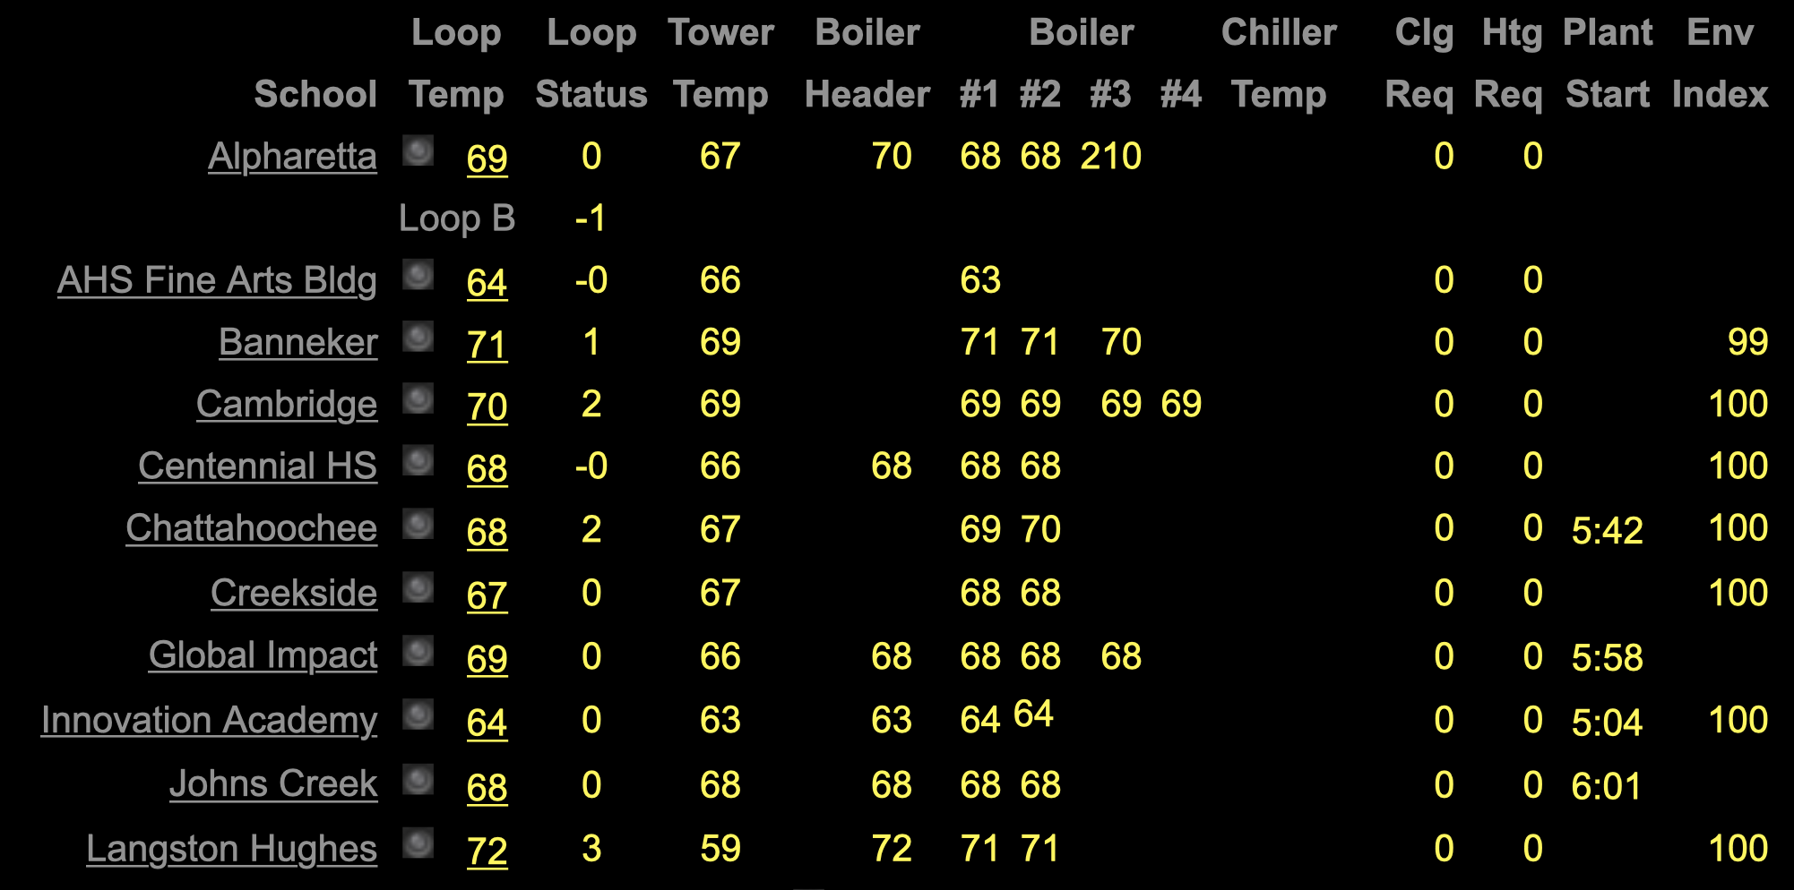
Plant Dashboards

Slide 20
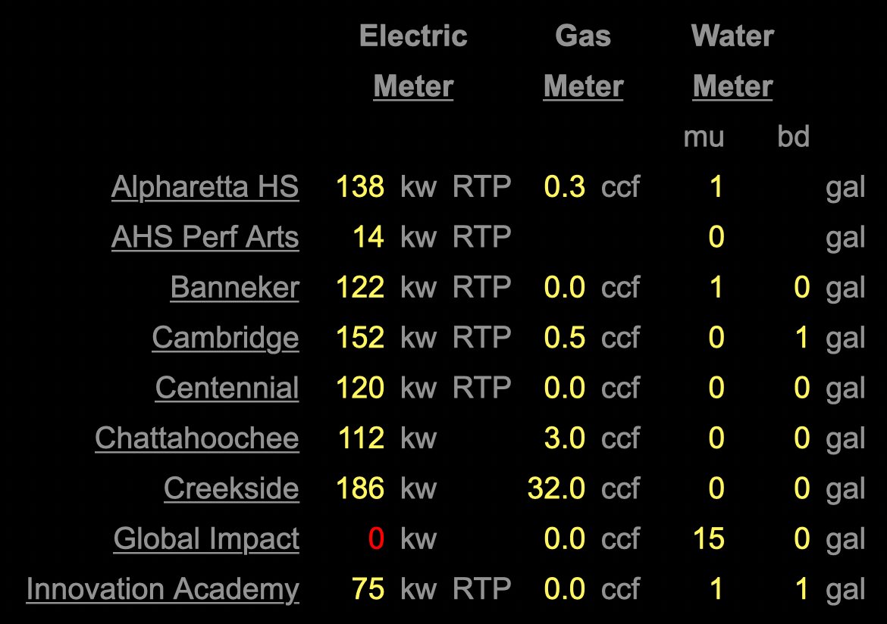
Meter Dashboards
Sunday Night @ 9pm

Slide 21
Misc Tactics
Automated e-mails for lighting waste
Intrusion system for tracking occupancy
IP based cameras for spotting energy waste
Mass e-mails to schools for high electric rates
Found incorrectly programmed electric meters

Slide 22
Future Tactics
Behavior modification at the school level
Dashboard for reducing energy use
Power usage for lighting
Motion sensors & HVAC occupancy
System-wide LED project

Slide 23
Questions?

